Slide 1
Types of Language Models so far

Slide 2
GPT-2 uses masked attention
Text generation models and its applications
Text generation with entity recognition
Datasets used so far and ones that are untapped
NLP conferences

Slide 3
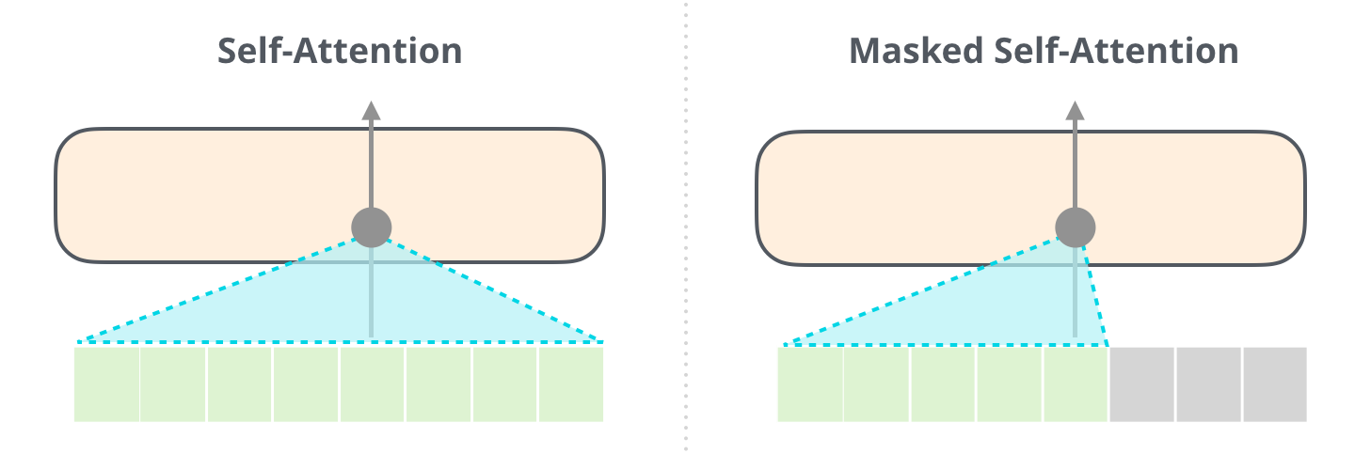
GPT-2 uses masked attention
Normal self-attention block allows a position to peak at tokens to its right.
Masked self-attention prevents that from happening, which means that they only use the left context to predict the next word.
Make sure that the states do not attend to tokens that are "in the future" but only to those "in the past“

Slide 4
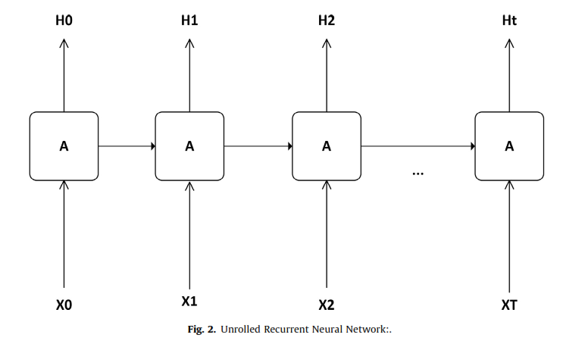
Algorithms used for Text Generation
RNN: Recurrent Neural Networks contain internal memory
Training of RNNs is very difﬁcult because of Modeling long term dependencies:
Exploding gradient; algorithm assigns high results to weights which makes the model learn nothing
Vanishing gradient; where the values of the gradient are too small and the model stops learning.
LSTM: Long Short Term Memory
Inherits the same architecture as vanilla RNNs, without hidden state

Slide 5
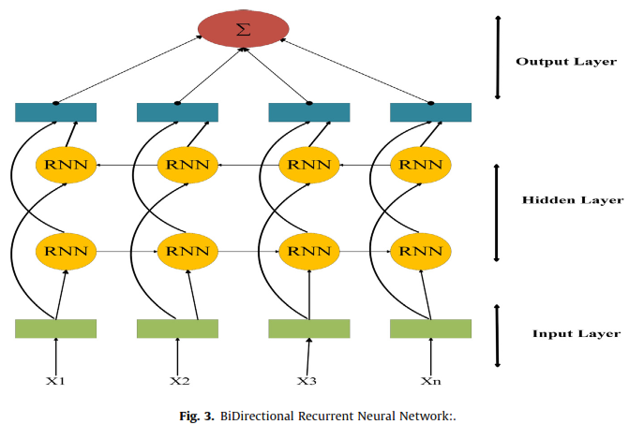
GRU: Gated Recurrent Unit
Modiﬁes LSTM architecture with a gating network.
Simpler than LSTM in which the parameter updation is also used for gates according to the algorithm
BRNN: Bi-directional RNNs
Output at time-step t may not only depend on previous elements but also on the future elements of the sequence.
Output of two RNNs must be combined, where one executes the process in the forward direction and second runs the process in the backward direction

Slide 6
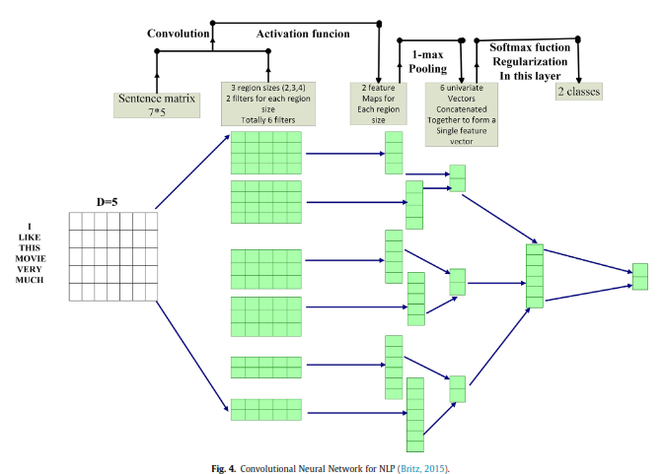
Extension of RNN: Extending the capability of neural networks by adding external memory source, which can interact with the attentional mechanism - Neural Turing Machines (NTM)
CNN: Convolutional Neural Networks
NLP tasks instead of image pixels use sentences, words or sometimes characters depends on problem classiﬁcation.

Slide 7
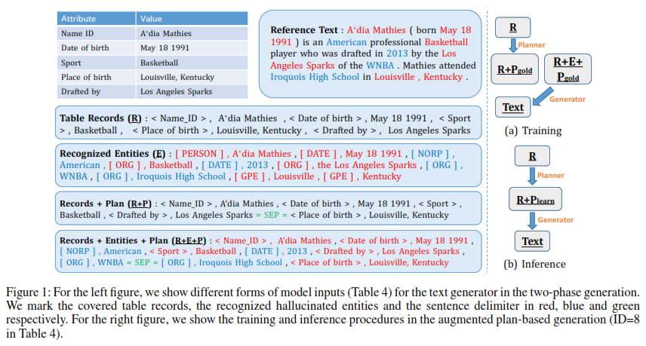
Text generation with Entity recognition
Feb 2021 paper: Towards Faithfulness in Open Domain Table-to-text Generation from an Entity-centric View

Slide 8
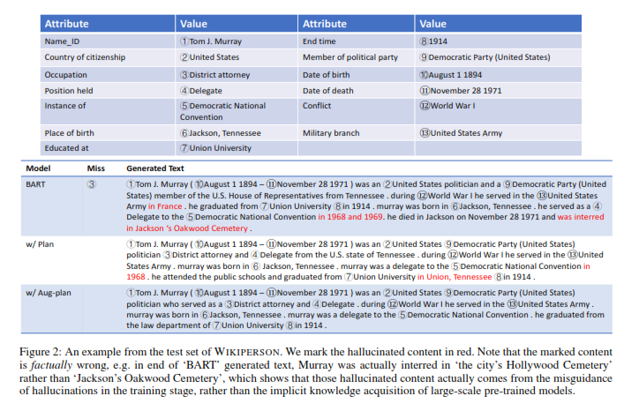

Slide 9
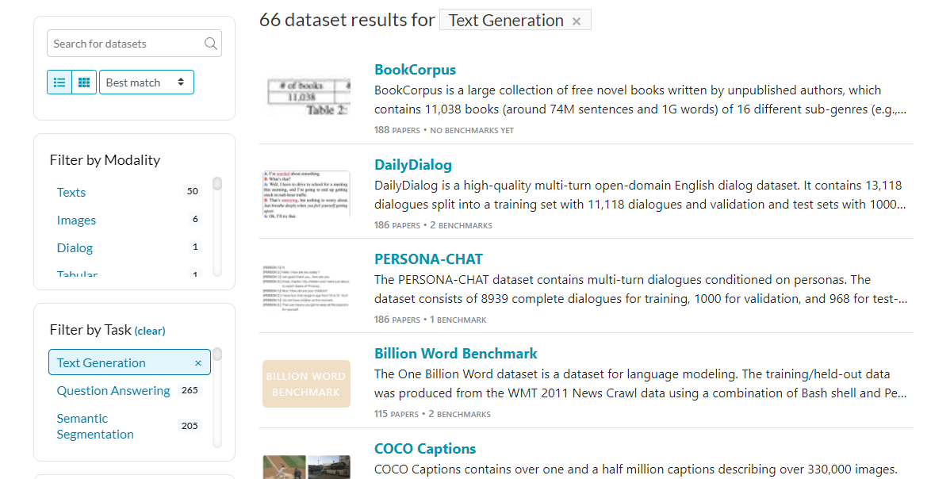
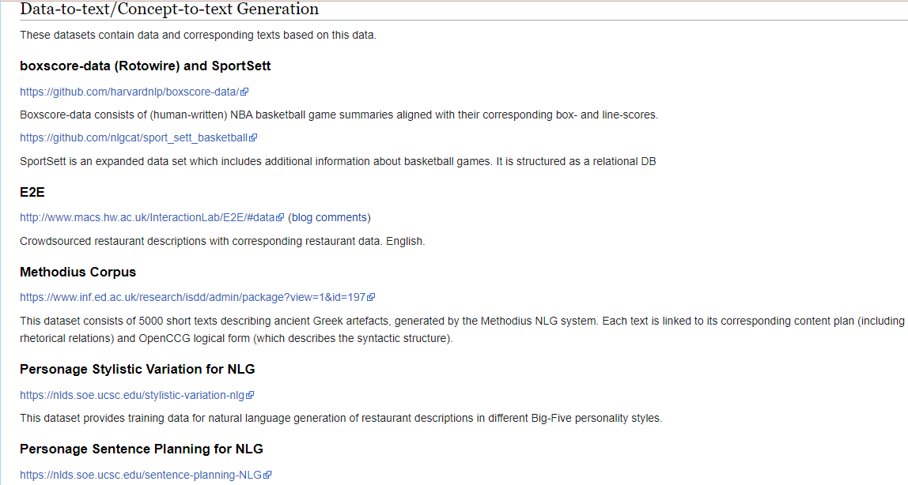
Datasets used so far and ones that are untapped
Collection of dataset along with benchmark model and number of papers written: https://paperswithcode.com/datasets?q=&v=lst&o=match&task=text-generation&page=1
Datasets for Natural Language Generation: https://aclweb.org/aclwiki/Data_sets_for_NLG

Slide 10
Datasets
Most popular datasets:
BookCorpus: Free novels by unpublished authors (74M sentences and 1G words, 16 sub-genres)
DailyDialog: Contains 13,118 dialogues split into a training set with 11,118 dialogues and validation and test sets with 1000 dialogues each
PersonaChat: Multi-turn dialogues conditioned on personas. The dataset consists of 8939 complete dialogues for training, 1000 for validation, and 968 for testing.
Least popular datasets:
WikiTableT: Wikipedia article sections and their corresponding tabular data and various metadata
WikiDocEdits: single-sentence edits crawled from Wikipedia
Texygen Platform: Benchmarking platform to support research on open-domain text generation models.

Slide 11
NLP Conferences
Top 10+2 NLP conferences with tips: https://www.junglelightspeed.com/the-top-10-nlp-conferences/
Conference index with upcoming dates: https://conferenceindex.org/conferences/natural-language-processing-nlp
ACL: Association for Computational Linguistics
EMNLP: Empirical Methods in Natural Language Processing
NAACL: North American Chapter of the Association for Computational Linguistics
EACL: European Chapter of the Association for Computational Linguistics
Focused on NLG: International Conference on Natural Language Generation

